Slide 1
Seismic Data Analysis
Presented By - The Geeks
1.Prabhat Kumar Sahu
2.Batakrishna Sahu
3.Suman Mishra
4.Nikita Jit

Slide 2
Problem Statement
Data Analysis and Development of Environmental Information System for Mining Areas in Odisha.

Slide 3
What is Data & Why It’s Important ?
What is Data ?
In general, data is any set of characters that has been gathered and translated for some purpose, usually analysis. It can be any character, including text and numbers, pictures, sound, or video. If data is not put into context, it doesn't do anything to a human or computer.
Why Data Is Important ?
Used to help decision-making
Predictive analytics
Can reveal patterns and trends and other crucial facts
Business Intelligence

Slide 4
“Data is the key”
You name any thing, the word Data is associated with it.

Slide 5
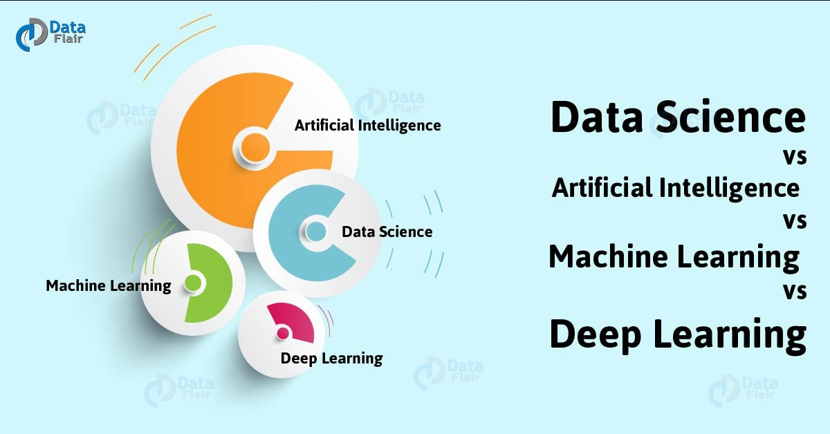
TRANSITION HEADLINE
The Buzz Words
1.
Data analysis :
Data analysis is a process of inspecting, cleansing, transforming, and modeling data with the goal of discovering useful information, informing conclusions, and supporting decision-making. Data analysis has multiple facets and approaches, encompassing diverse techniques under a variety of names, while being used in different business, science, and social science domains.

Slide 6
How big organization use Machine Learning & Data Analysis ?
Recommendation
Ecommerce (Flipkart,Amazon,Myntra..etc)
Netflix (Movie, Tv Series)
Spotify (Music)
Youtube (Relevant Videos)
Facebook news feed
Fraud and Risk Detection
Internet/Web Search
Digital Advertisement
Customer Interactions
Delivery logistics
Weather Prediction
More Use Cases
Image Recognition
Speech Recognition
Gaming
Smart Chatbots
Robotics
Self Driving Cars
Healthcare (Medical Imaging ..etc)
Intelligent transport systems
Congestion management by predicting traffic conditions

Slide 7
Seismic Data Analysis
Agenda :
Mines collect a lot of data but they don’t analyse and get the proper insights out of it.
With the information about the possibility of hazardous situation occurrence, an appropriate supervision service can reduce a risk of rockburst .
Solution :
Our analysis attempts to use logistic regression techniques to predict whether a seismic 'bump' is predictive of a notable seismic hazard. We attempt to characterize our prediction accuracy and compare the results against the state of the art results from other statistical and machine learning techniques, that are included within the data set.

Slide 8
What Is Seismic Data ?
Mining activity has long been associated with mining hazards, such as fires, floods, and toxic contaminants .
Among these hazards, seismic hazards are the hardest to detect and predict.Minimizing loss from seismic hazards requires advanced data collection and analysis.
In recent years, more and more cutting-edge seismic and seismo-acoustic monitoring systems have come about. Still, the disproportionate number of low-energy versus high-energy seismic phenomena renders traditional analysis methods insufficient in making accurate predictions.

Slide 9
How People Work At Coal Mines?

Slide 10
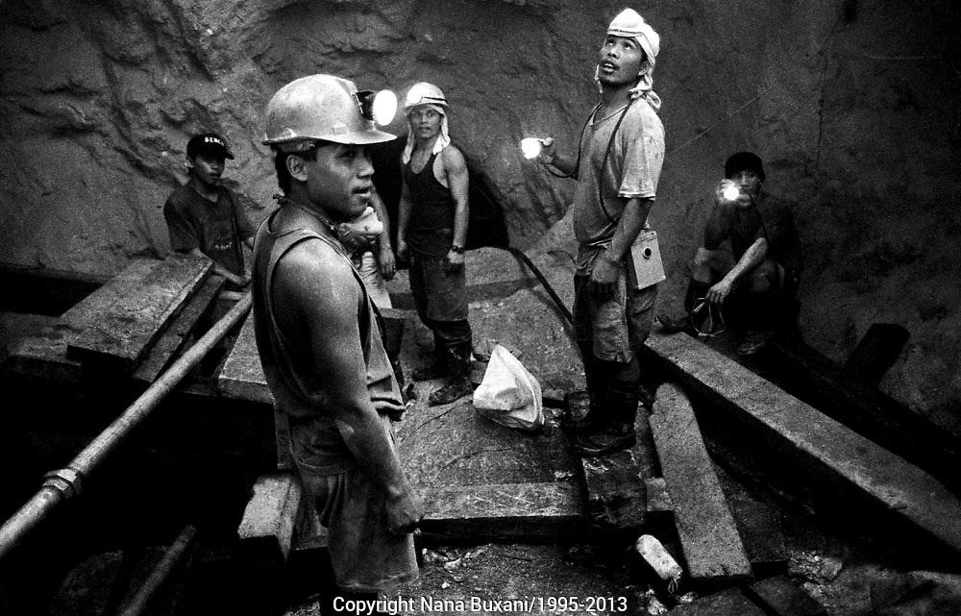
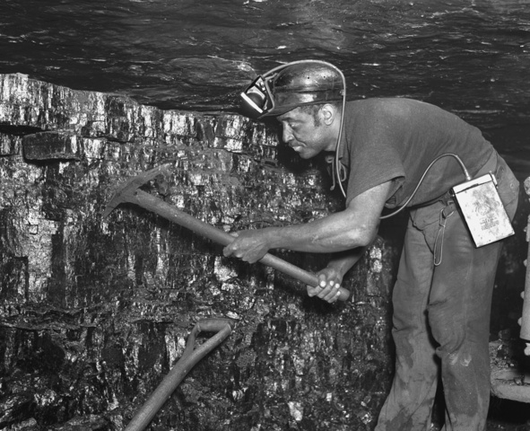
People Working Under Mines

Slide 11
Seismic Data Analysis : Introduction
The dangers associated with coal mining are myriad; black lung, flammable gas pockets, rock-bursts, and tunnel collapses are all very real dangers that mining companies must consider when attempting to provide safe working conditions for miners.
One class of mining hazard, commonly called 'seismic hazards', are notoriously difficult to protect against and even more difficult to predict with certainty. Therefore, predicting these hazards has become a well-known problem for machine learning and predictive analytics.

Slide 12
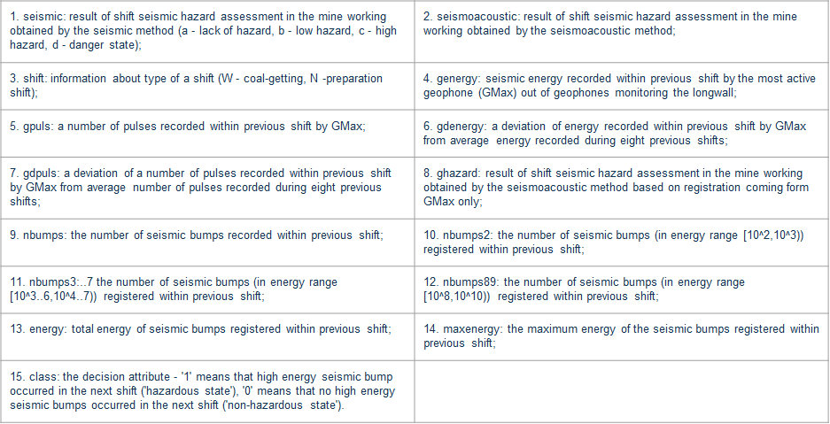
Attribute Information

Slide 13
Dataset Description
The data were taken from instruments in the Zabrze-Bielszowice coal mine, in Poland.
There are 2,584 records, with only 170 class = 1 variables, so the data are significantly skewed towards non-hazardous training data.
Essentially energy readings and bump counts during one work shift are used to predict a 'hazardous' bump during the next shift
From the data description, a 'hazardous bump' is a seismic event with > 10,000 Joules, and a 'shift' is a period of 8 hours.
For the sake of reference, a practical example of 10,000 Joules would be the approximate energy required to lift 10,000 tomatoes 1m above the ground.
A class = 1 variable result signifies that a hazardous bump did, indeed, occur in the following shift to the measured data.

Slide 14
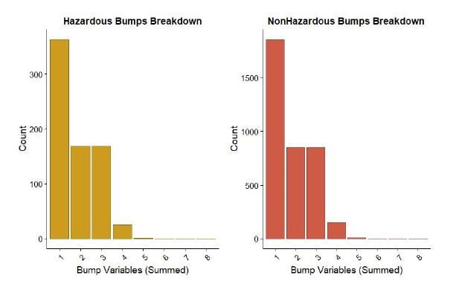
Main Effects
The main effects for this study are considered to be the all numeric variables, plus ghazard, seismoacoustic and shift.
The nbumps class of variables are left out for more advanced models
Since the resonance and frequency ranges could have a multitude of confounding variables that we, without significant mining expertise, would miss.
To test that nbumps isn’t necessarily the largest effect, we looked at a side-by-side histogram of nbump records for each of the two output classes:
The pattern of frequency distributions appears to be consistent, regardless of class. Therefore, we will not be making ‘nbumps’ one of our main effects variables.

Slide 15
Logistic Regression Assumptions
Independence of Observations:
We are making the assumption that each measurement is an independent measurement, taken at different times, from the same mine. This is based on the data set description at the UCI Machine Learning repository, and the fact that you can’t take multiple simultaneous readings from the same instrument.
Output Variable :
Logistic regression requires a categorical output variable. In this case, our output variable (class) is a binary categorical variable.

Slide 16
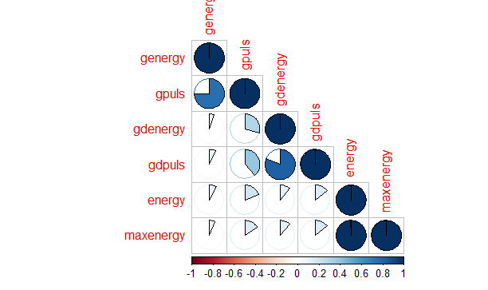
Multi-collinearity
We used the following chart to assess the correlation of variables with each other. The most highly correlated variables are energy and maxenergy.
It is also interesting that the gpuls:genergy and gdpuls:gdenergy are somewhat correlated
For this model, we decided to leave all the main effects variables intact and address any multicollinearity issues after glmnet’s automatic feature selection, if necessary (spoiler: it wasn’t).

Slide 17
Full Model
We first built a logistic regression model taking all the observations and variables into account
Next we predict using this full model and calculate the probability of getting a hazardous bump.
To convert these probabilities to classes, we defined a threshold.
A good value for threshold is the mean of the original response variable.
Probabilities greater than this threshold are categorized into hazardous bump class and probabilities lesser than the threshold are categorized into non-hazardous bump class.
Model accuracy is then calculated by comparing with the actual class variable. Our calculation show that the logistic regression model with all the observations and variables made a correct prediction 59% of the time.

Slide 18
Accuracy using other ML Algorithms
Decision Tree : 0.8897485493230
KNN: 0.9323017408123792
Naive Bayes: 0.11798839458413926,
Random Forest': 0.9226305609284333
LinearSVC': 0.9264990328820116
Feed Forward NN : 0.9129593810444874

Slide 19
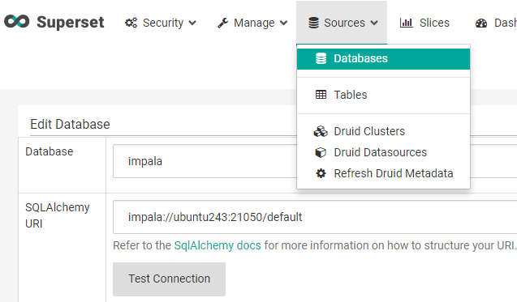
Application In Production : Part - 1 ( Data Visualization)
Writing code for data visualization takes lot of time & effort
Solution :
Using Apache Superset
Upload Your CSV or Connect to Your Database and Visualize like a pro.
Multiple chats are available.

Slide 20
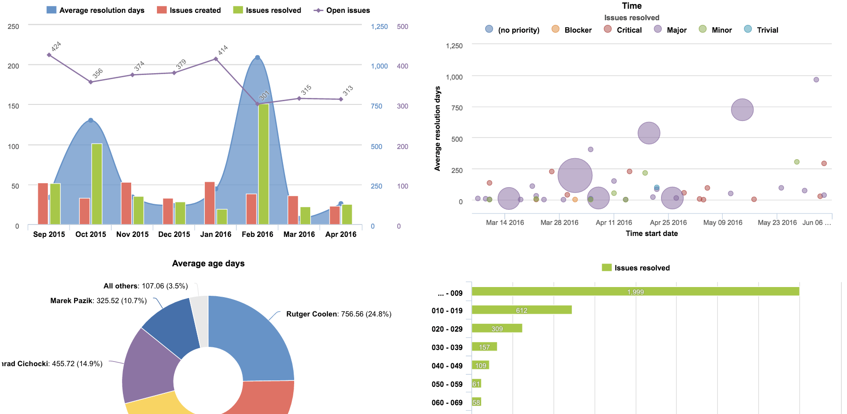

Slide 21

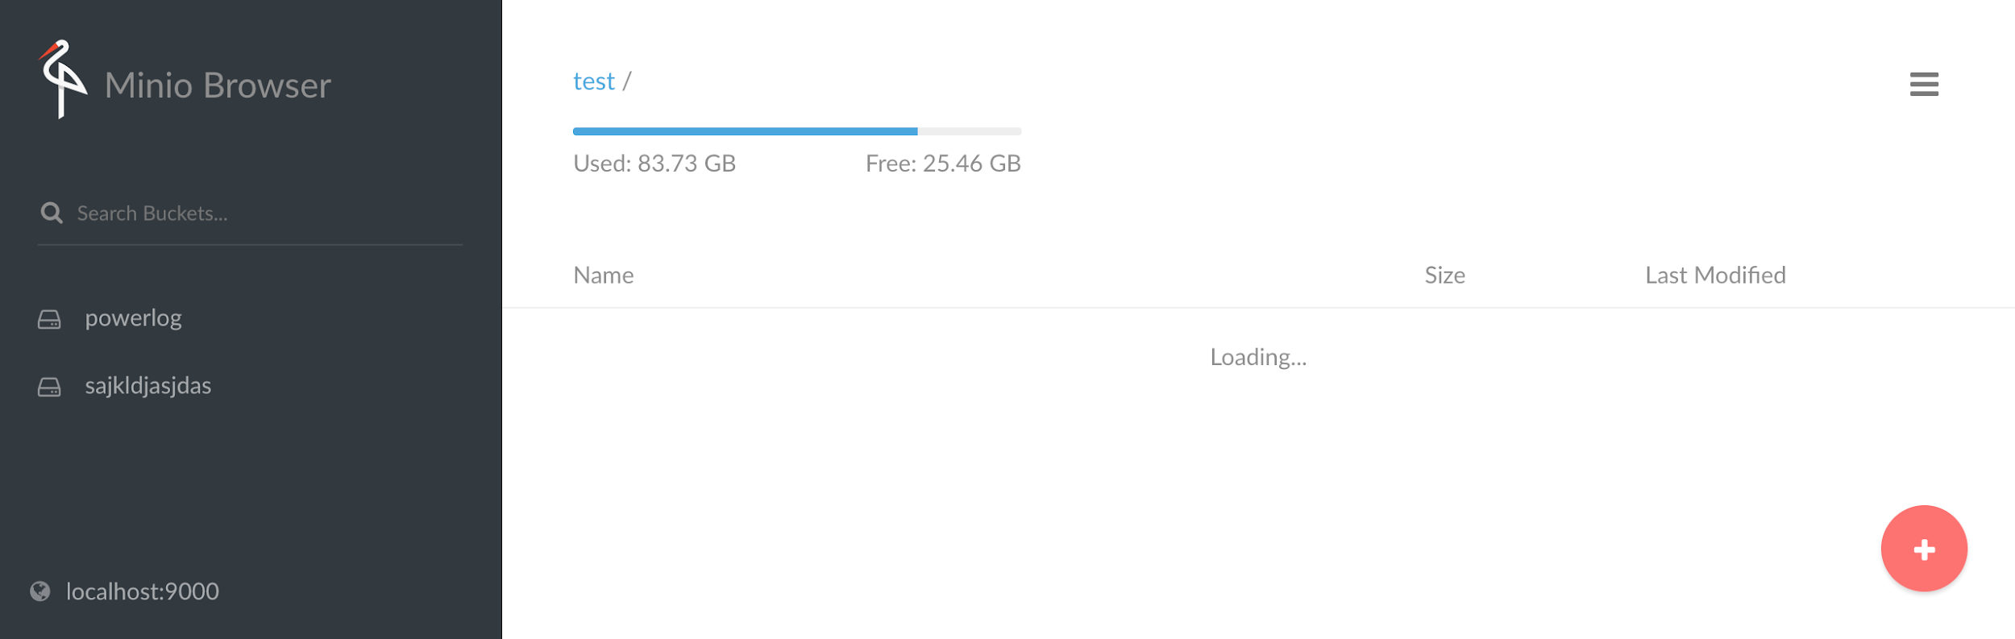
Application In Production : Part - 2 ( Building Model )
Minio
Minio Browser provides minimal set of UI to manage buckets and objects on minio server.
Having an S3-compatible API means once configured, Minio acts as a gateway to B2.

Slide 22
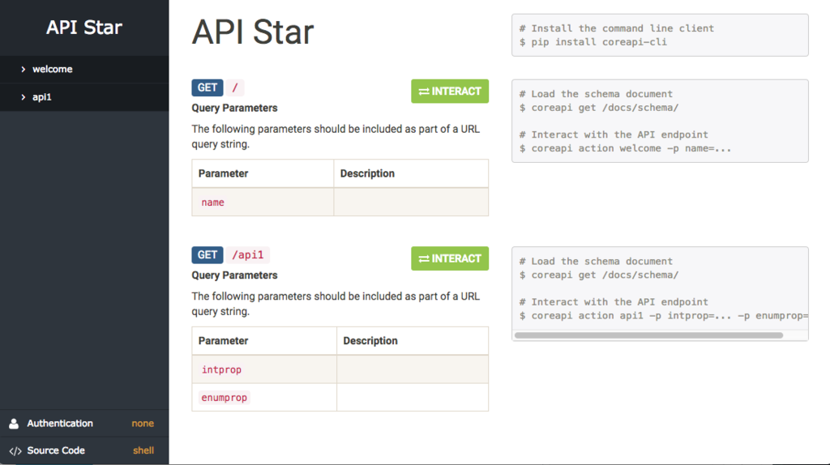
Application In Production : Part - 3 ( Predict as a Service)
API Star
API Star is a toolkit for working with OpenAPI or Swagger schemas.
No need to write REST-API From scratch.
Validate API schema documents, and provide contextual errors.
Validate requests and responses
Can integrate with frameworks like Django & Flask.

Slide 23
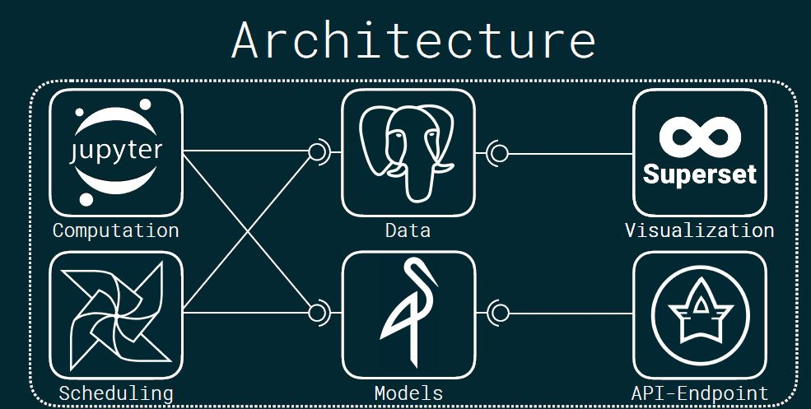

Slide 24
Conclusion
This seismic bump problem is an interesting problem, an important problem, and has a fascinating data set.
We chose to Randomly Under-Sample, but we could also do Synthetic Minority Over-Sampling, Cluster-Based Over-Sampling, Random Over-Sampling, Algorithmic Ensemble Sampling, Bagging, Boosting, and probably many other techniques which aren’t covered in a graduate level statistics course.
We chose a pretty straightforward solution, which definitely impacts the performance of our model. Our logistic regression model predicts the test set with around 60 to 70% accuracy, after random under-sampling.
While the methods for calculating the results of these various methods aren’t clearly documented in the data set, we can assume that we understand a few of them through inference. Accuracy (Acc.) is the percentage of times our model correctly predicted the class in the test set.

Slide 25
Some different ideas on this dataset:
Where are the geophones located? Is it possible to do TRM (time reverse modeling) of stress wave propagation? With this dataset we simply know that if a rock burst occurs in a longwall but not where.
What to do with the results? We may end up knowing if a rock burst is likely to occur or not. Can we use the recorded data to estimate locations and therefore control stress release before the burst?
Can we extract another set of useful information from the raw data from the geophones (what we got here is heavily processed)?

Slide 26
Future Improvements
We can use Deep Learning Algorithms like RNN, LSTM models to improve the accuracy.
Can make a Docker Image of our architecture and serve it as a web app.

Slide 27

Thank You !
Any questions?
Drop a mail at : prabhat.kumar.sahu@suiit.ac.in
You can get the code at my Github repo-
https://github.com/TheCaffeineDev/Seismic-Data-Analysis
Or
https://bit.ly/2Qm16Zi

